Slide 1
Sales Data Analysis of Small Stores
Trends • Insights • Visualizations

Slide 2
Introduction
This deck explores sales trends for small retail stores using synthetic, realistic sample data.
We highlight growth patterns, category contributions, seasonality, and regional differences.
Visuals and tables are included to make insights easy to grasp.

Slide 3
Data Overview
Transactions from 2020–2024 (sampled).
Key fields: Date, Store_ID, Product/Category, Amount, Region.
Aggregations used: yearly totals, monthly seasonality, category shares, regional mix.

Slide 4
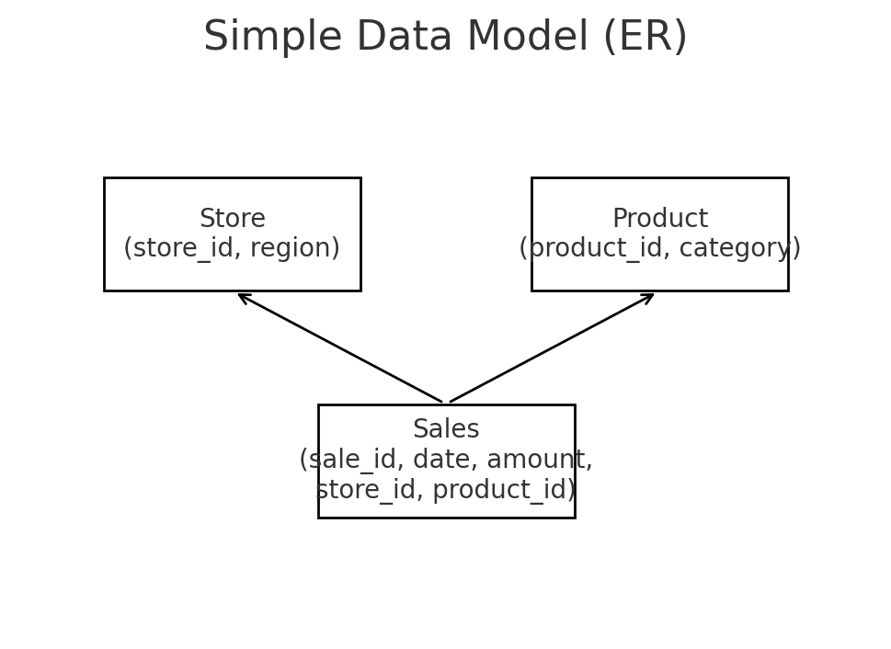
Data Model (ER Overview)
Sales links Store and Product; measures include date and amount.

Slide 5
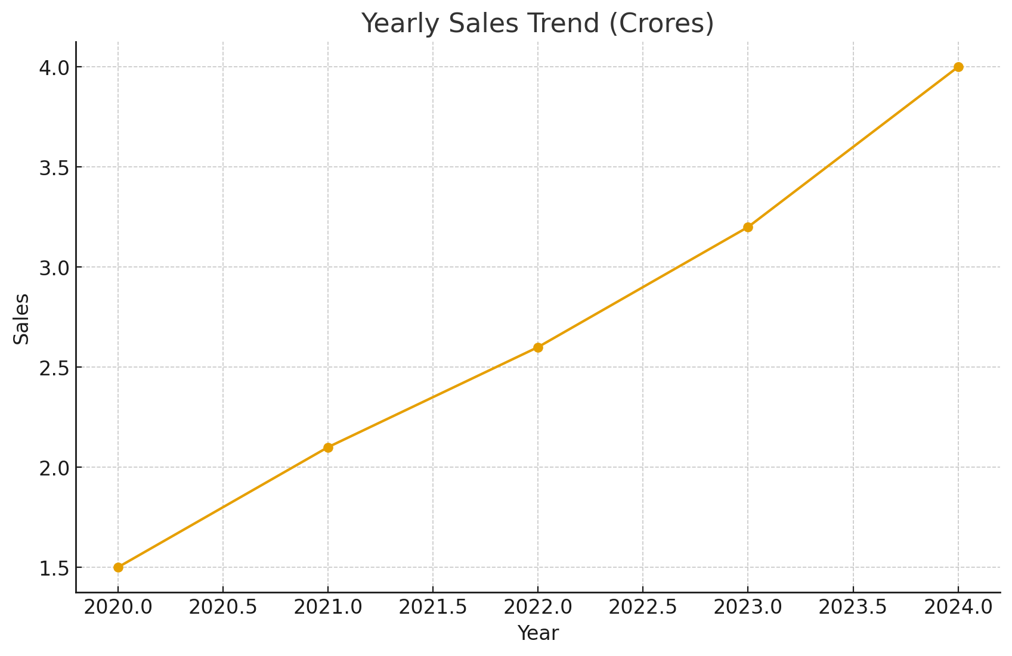
Yearly Sales Trend
Consistent growth from 2020 to 2024.

Slide 6
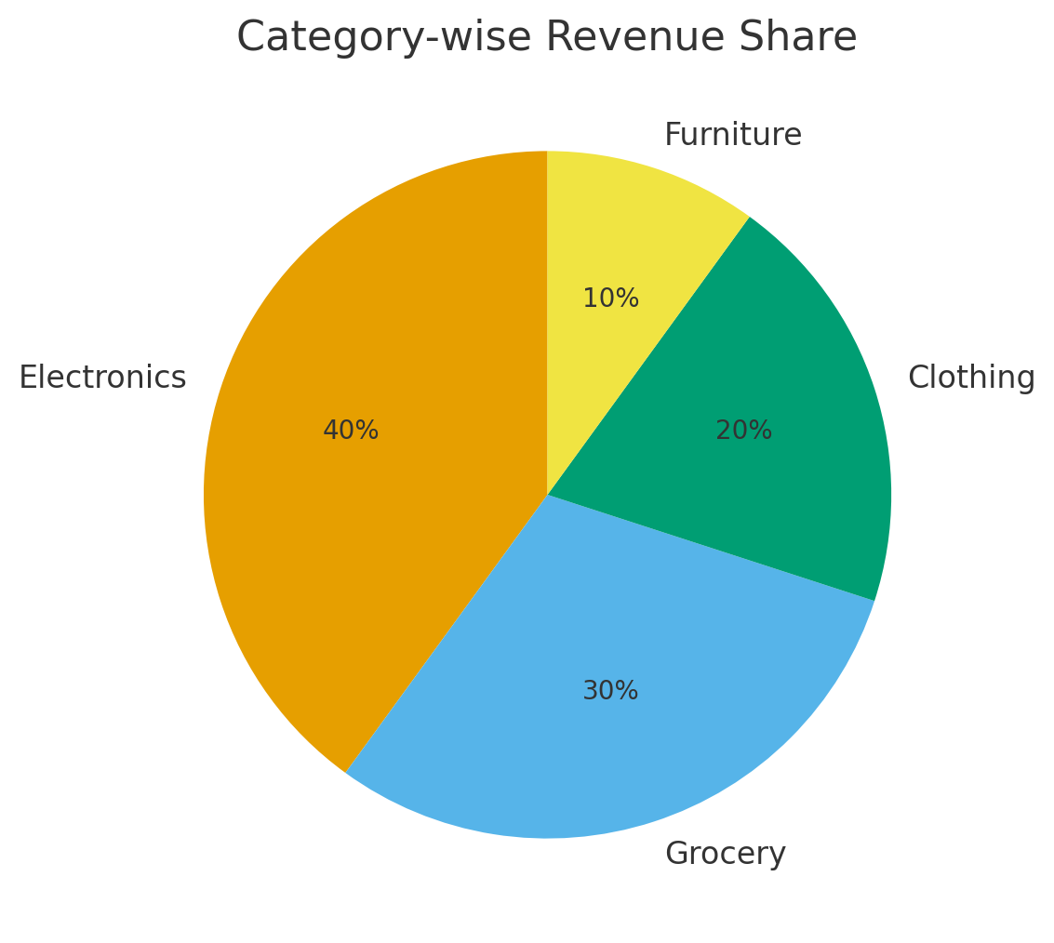
Category-wise Revenue Share
Electronics and Grocery dominate overall revenue contribution.

Slide 7
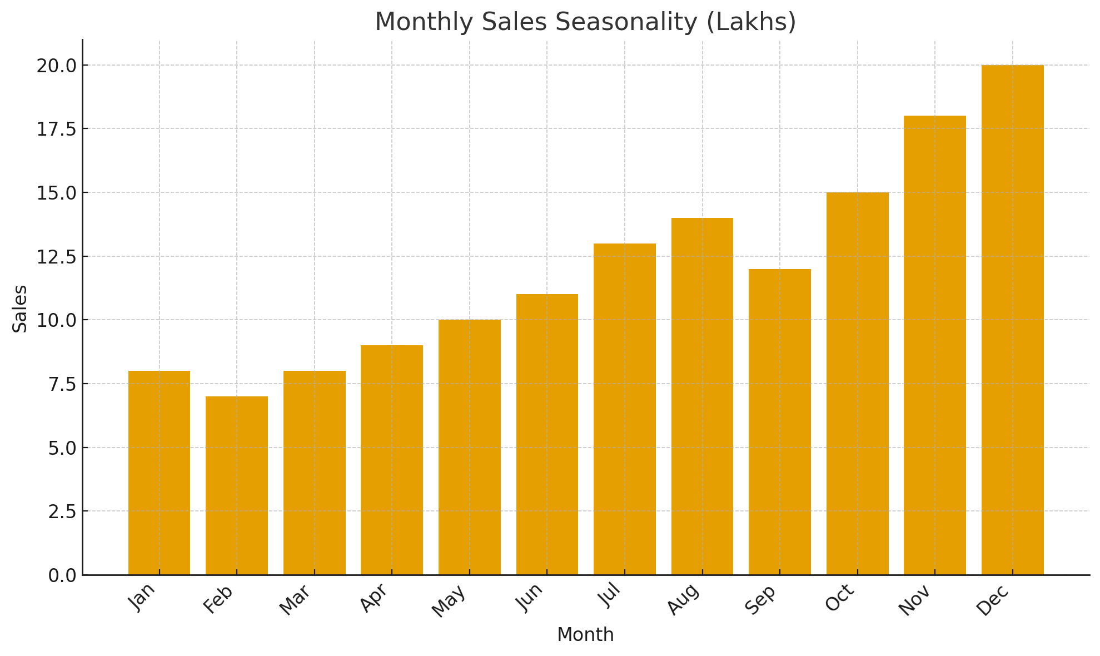
Monthly Sales Seasonality
Festive months show noticeable spikes compared to off-season months.

Slide 8
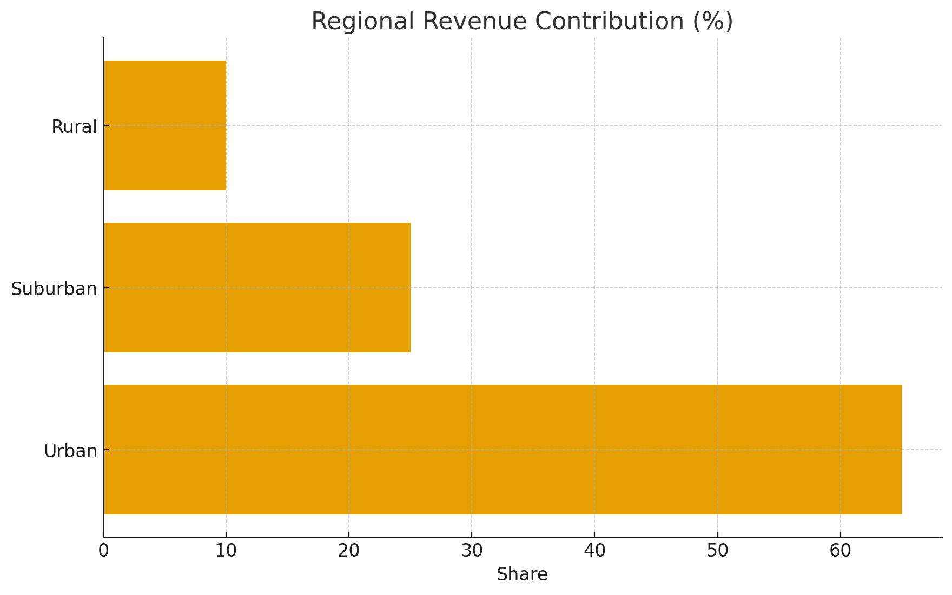
Regional Performance Mix
Urban stores contribute the majority of revenue, followed by suburban and rural.

Slide 9
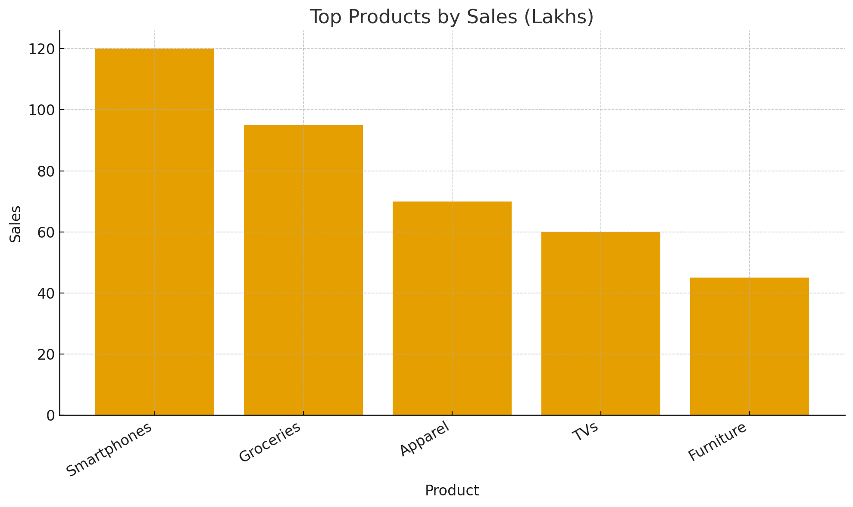
Top Products by Sales
Smartphones and Groceries lead, indicating a strong essentials + electronics mix.

Slide 10
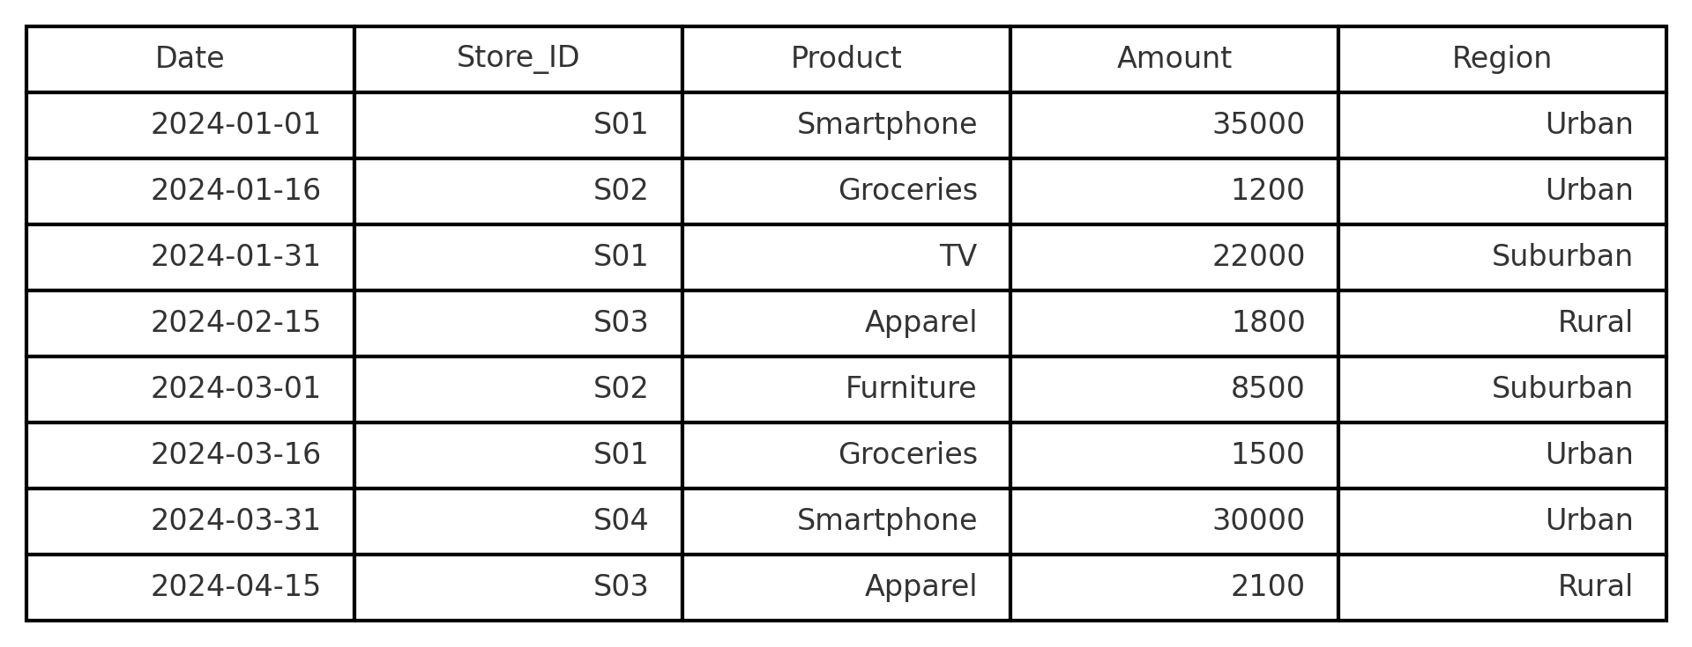
Sample Data Table (Screenshot-style)
A peek at the underlying records used for aggregates and visuals.

Slide 11
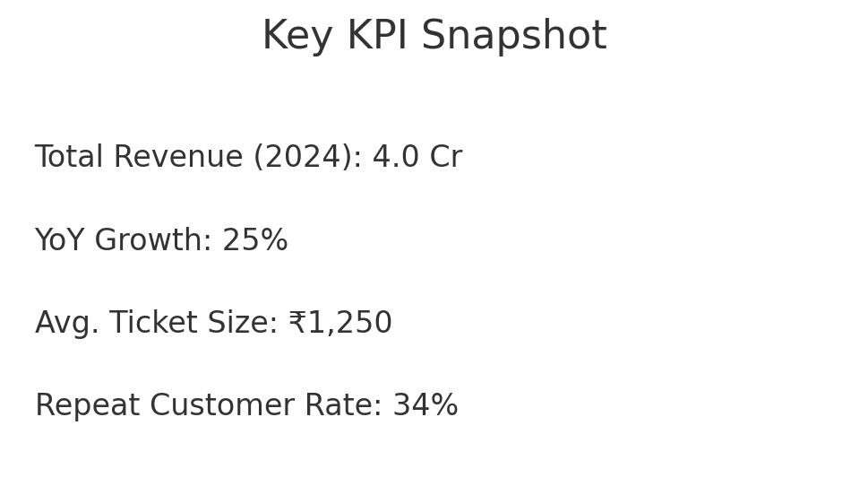
KPI Snapshot
At-a-glance metrics to share with stakeholders.

Slide 12
Recommendations
Double down on peak-season inventory and campaigns.
Expand electronics assortment in high-performing urban stores.
Build targeted promos in suburban areas to lift share.
Use demand forecasting to reduce stockouts.
Track repeat-customer initiatives to raise loyalty.

Slide 13
Conclusion
Sales analysis reveals clear growth and category concentration.
Seasonality and regional mix guide inventory and marketing.
Continue monitoring trends to sustain momentum.

